Slide 1
Diffie-Hellman Key Exchange
Diffie–Hellman key exchange is a specific method of exchanging cryptographic keys.
It is the key exchange implemented within the field of cryptography.
The Diffie–Hellman key exchange method allows two parties that have no prior knowledge of each other to jointly establish a shared secret key over an insecure communications channel.
This key can used to encrypt subsequent communications using a symmetric key cipher.

Slide 2
Diffie-Hellman Key Exchange
A B
A, g^{x}
B, g^{y}
both parties compute the secret key K=g^{xy}
but Man-in-the-middle attack may be possible
<number>

Slide 3
Each party signs its own DH value to prevent m-i-t-m attack.
A: “Shared K=gxy with B” (K⬄B) B: “Shared K=gxy with A” (K⬄A)
^{Looks fine, but…}
Basic Authenticated DH (BADH)
A, g^{x}
A
B
B, g^{y, SIG}_{B(g}^{x,gy)}
SIG_{A(g}^{y,gx)}
<number>
Notes:
<number>
Say ID prot’n later

Slide 4
Identity-Misbinding Attack^{*(Unknown Key-Share attack)}
A, g^{x}
E, g^{x}
A
E
B
B, g^{y, SIG}_{B(g}^{x,gy)}
B, g^{y, SIGB(gx,gy)}
SIGA(g^{ygx)}
SIG E (g^{y, gx)}
Wrong identity binding!
E doesn’t know K=gxy but B considers anything sent by A as coming from E
<number>

Slide 5
A: “Shared K=gxy with B” (K⬄B) B: “Shared K=gxy with E” (K⬄E)
B = Bank A,E = customers
A B: {“deposit $1000 in my account”}_{K}
B deposits the money in “K” ’s account, i.e. E’s!
Identity Misbinding Attack: the “differential cryptanalysis of key-exchange protocols”
03Crypto - Hugo Krawczyk
<number>

Slide 6
A Possible Solution
A, g^{x}
A
B
B, g^{y, SIG}_{B(g}^{x,gy,A)}
SIG_{A(g}^{y,gx,B)}
03Crypto - Hugo Krawczyk
Prevent the identity-misbinding attack by including the identity of the peer under the signature
<number>

Slide 7
The ISO defense
A, g^{x}
E, g^{x}
A
E
B
B, g^{y, SIG}_{B(g}^{x,gy,E)}
B, g^{y, SIG}_{B(g}^{x,gy,E)}
03Crypto - Hugo Krawczyk
A: aha! B is talking to E not to me!
Note that E cannot produce SIG_{B(g}^{x,gy,A)}
The ISO protocol thus avoids the misbinding attack.
<number>

Slide 8
Diffie-Hellman Key Exchange Example
Example: Suppose Alice and Bob agree to
use p = 47 and g = 5.
Alice chooses a number between 0 and 46,
say a = 18.
Bob chooses a number between 0 and 46,
say b = 22.

Slide 9
Alice publishes g ^{a (mod p), i.e.}
^{u = 518 (mod 47) = 2.}
^{public key Alice = 2}
^{Bob publishes gb (mod p), i.e.}
^{v = 522 (mod 47) = 28.}
^{public key Bob = 28}

Slide 10
If Alice wants to know the secret key k, she takes Bob’s public number, v = 28, and raises it to her private number, a = 18 (taking the result mod 47).
This gives her: 28^{18 (mod 47) = 24.}
If Bob wants to know the secret key, he takes Alice’s public number, u = 2, and raises it to his private number, b = 22 (taking the result mod 47).
This gives him: 222 (mod 47) = 24.
^{Final Result:-}
Thus, Alice and Bob have agreed upon a secret key, k = 24

Slide 11
Encryption & Decryption techniques

Slide 12
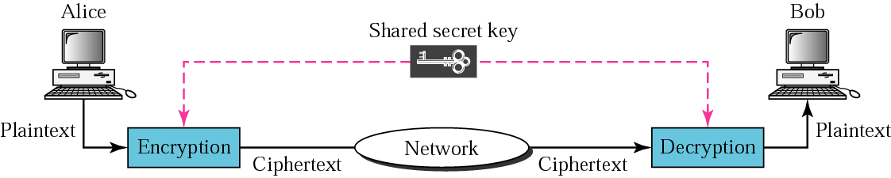
Symmetric-key cryptography
<number>

Slide 13


Symmetric Encryption
Key
Key
Alice
Bob
Plaintext
Ciphertext
Plaintext
Encryption
Algorithm
Decryption
Algorithm
Notes:
<number>
Animated figure of terms
Plaintext, ciphertext, encrypt, decrypt, key, algorithm

Slide 14
In symmetric-key cryptography, the same key is used in both directions.

Slide 15
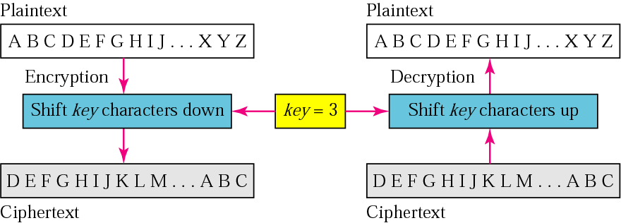
Caesar cipher

Slide 16
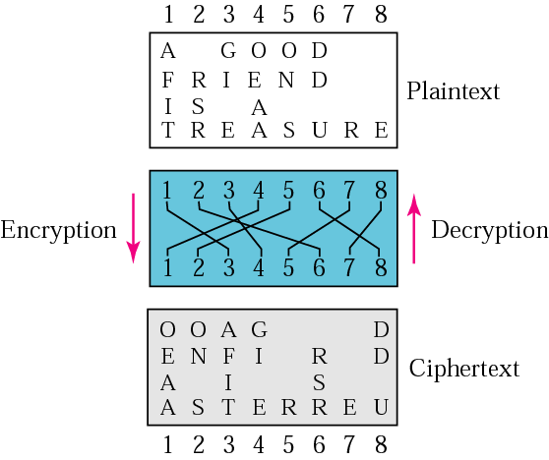
Transposition cipher

Slide 17
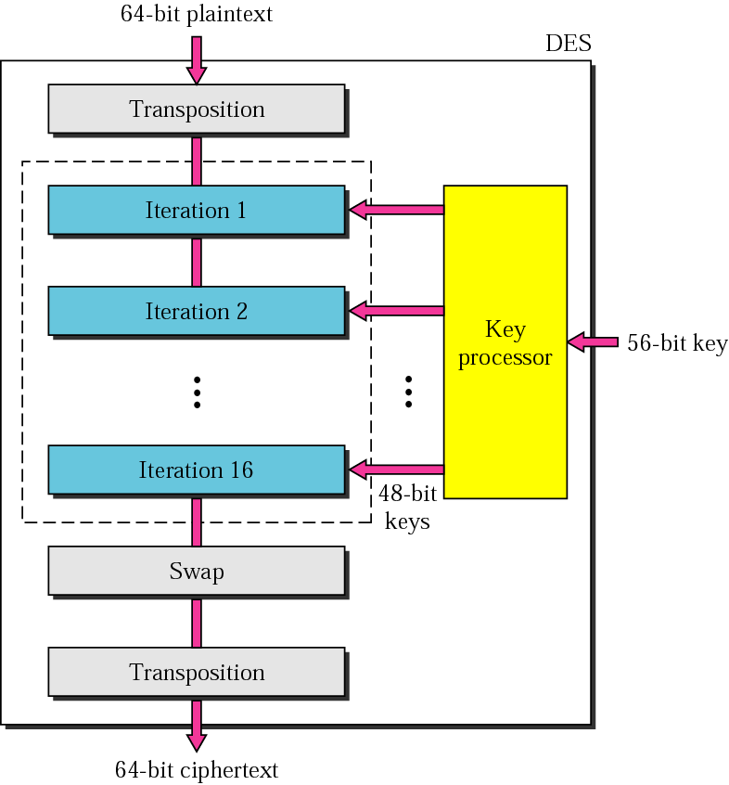
DES

Slide 18
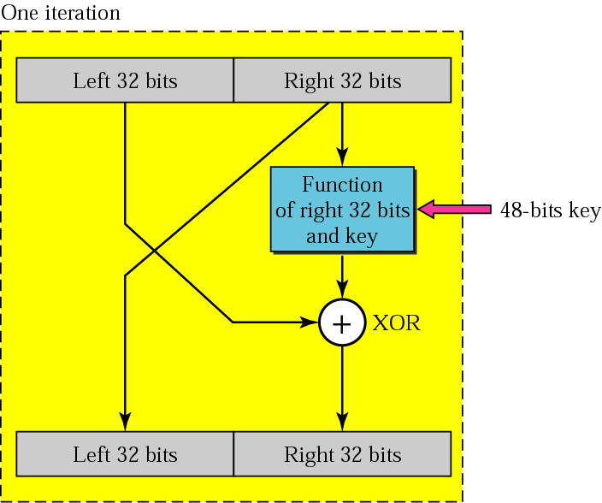
Iteration block

Slide 19
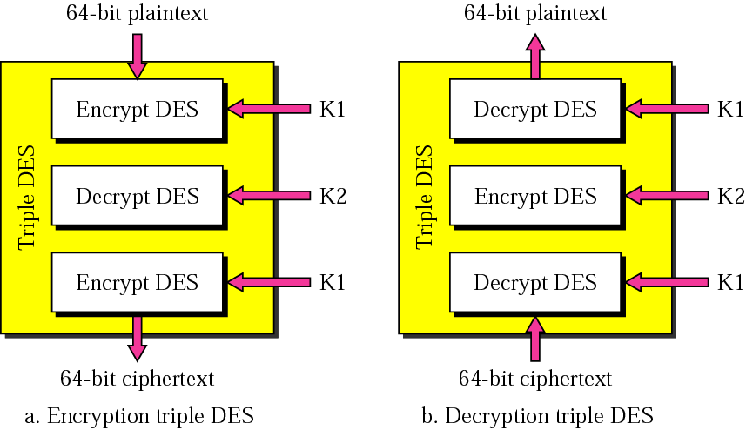
Triple DES

Slide 20
How was AES created?
AES competition
Started in January 1997 by NIST
4-year cooperation between
U.S. Government
Private Industry
Academia
Why?
Replace 3DES
Provide an unclassified, publicly disclosed encryption algorithm, available royalty-free, worldwide

Slide 21
Evaluation Criteria
Security
Resistance to cryptanalysis, soundness of math, randomness of output, etc.
Cost
Computational efficiency (speed)
Memory requirements
Algorithm / Implementation Characteristics
Flexibility, hardware and software suitability, algorithm simplicity

Slide 22

AES is a non-Feistel cipher that encrypts and decrypts a data block of 128 bits. It uses 10, 12, or 14 rounds. The key size, which can be 128, 192, or 256 bits, depends on the number of rounds.
7.<number>
Note
AES has defined three versions, with 10, 12, and 14 rounds.
Each version uses a different cipher key size (128, 192, or 256), but the round keys are always 128 bits.
Notes:
<number>

Slide 23
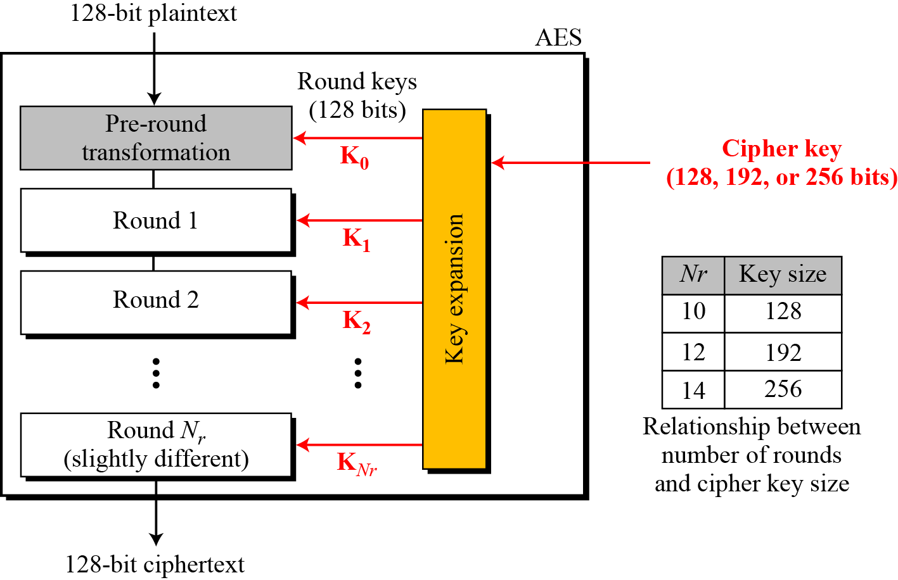
General design of AES encryption cipher
7.<number>
Notes:
<number>

Slide 24
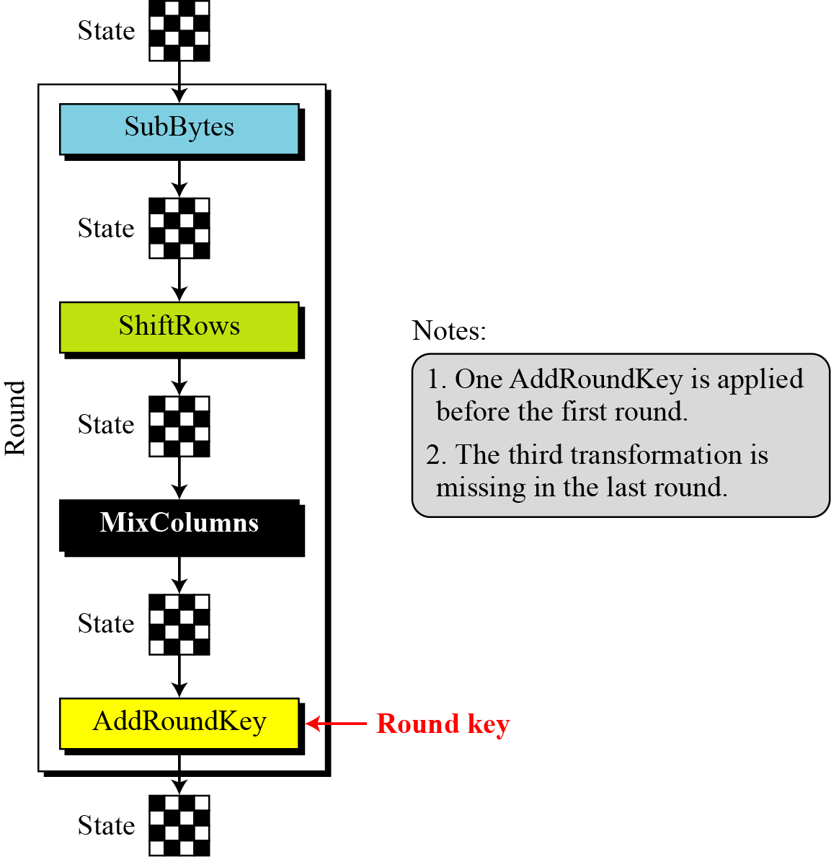
Structure of each round at the encryption site
7.<number>
Notes:
<number>

Slide 25
AES methods
Convert to state array
Transformations (and their inverses)
AddRoundKey
SubBytes
ShiftRows
MixColumns
Key Expansion

Slide 26
Encryption
byte state[4,Nb]
state = in
AddRoundKey(state, keySchedule[0, Nb-1])
for round = 1 step 1 to Nr–1 {
SubBytes(state)
ShiftRows(state)
MixColumns(state)
AddRoundKey(state, keySchedule[round*Nb, (round+1)*Nb-1])
}
SubBytes(state)
ShiftRows(state)
AddRoundKey(state, keySchedule[Nr*Nb, (Nr+1)*Nb-1])
out = state
Prevents an attacker from even beginning to encrypt or decrypt without the key
First and last operations ivolve the key

Slide 27
Decryption
byte state[4,Nb]
state = in
AddRoundKey(state, keySchedule[Nr*Nb, (Nr+1)*Nb-1])
for round = Nr-1 step -1 downto 1 {
InvShiftRows(state)
InvSubBytes(state)
AddRoundKey(state, keySchedule[round*Nb, (round+1)*Nb-1])
InvMixColumns(state)
}
InvShiftRows(state)
InvSubBytes(state)
AddRoundKey(state, keySchedule[0, Nb-1])
out = state

Slide 28
Encrypt and Decrypt
Encryption AddRoundKey SubBytes ShiftRows MixColumns AddRoundKey SubBytes ShiftRows AddRoundKey | Decryption AddRoundKey InvShiftRows InvSubBytes AddRoundKey InvMixColumns InvShiftRows InvSubBytes AddRoundKey

Slide 29
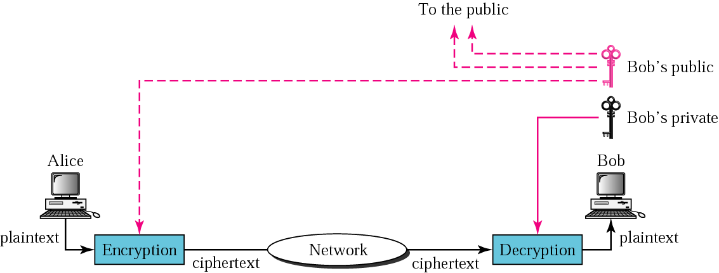
Public-key cryptography
<number>

Slide 30
NOTE:-
Symmetric-key cryptography is often used for long messages.
Asymmetric-key algorithms are more efficient for short
messages.
Digital signature can provide authentication, integrity, and
nonrepudiation for a message.

Slide 31
DIGITAL SIGNATURE
Digital signature can provide authentication, integrity, and nonrepudiation for a message.

Slide 32
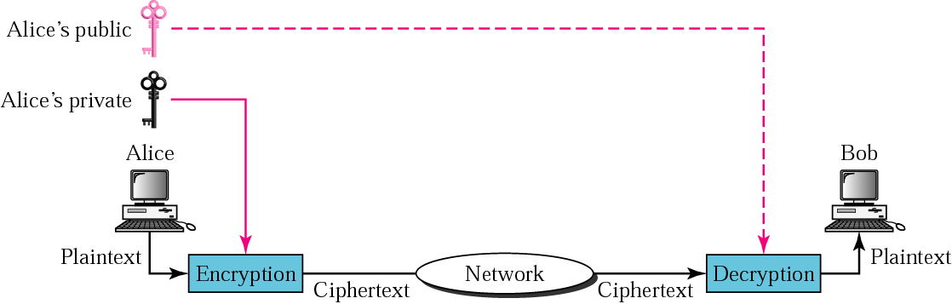
Signing the whole document

Slide 33
Note:
Digital signature does not provide privacy. If there is a need for privacy, another layer of encryption/decryption must be applied.

Slide 34
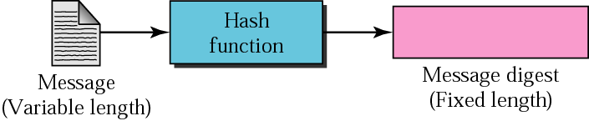
Hash function

Slide 35
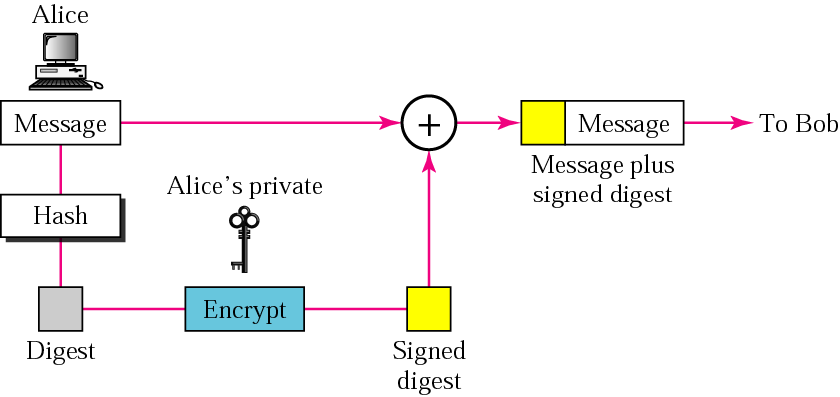
Sender site

Slide 36
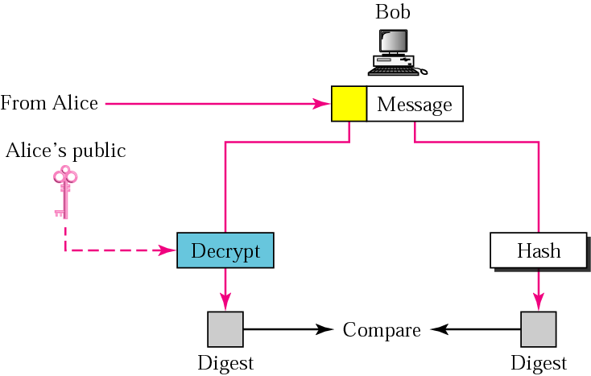
Receiver site

Slide 37

Thank you……………
ANY QUERIES?.....

